Slide 1
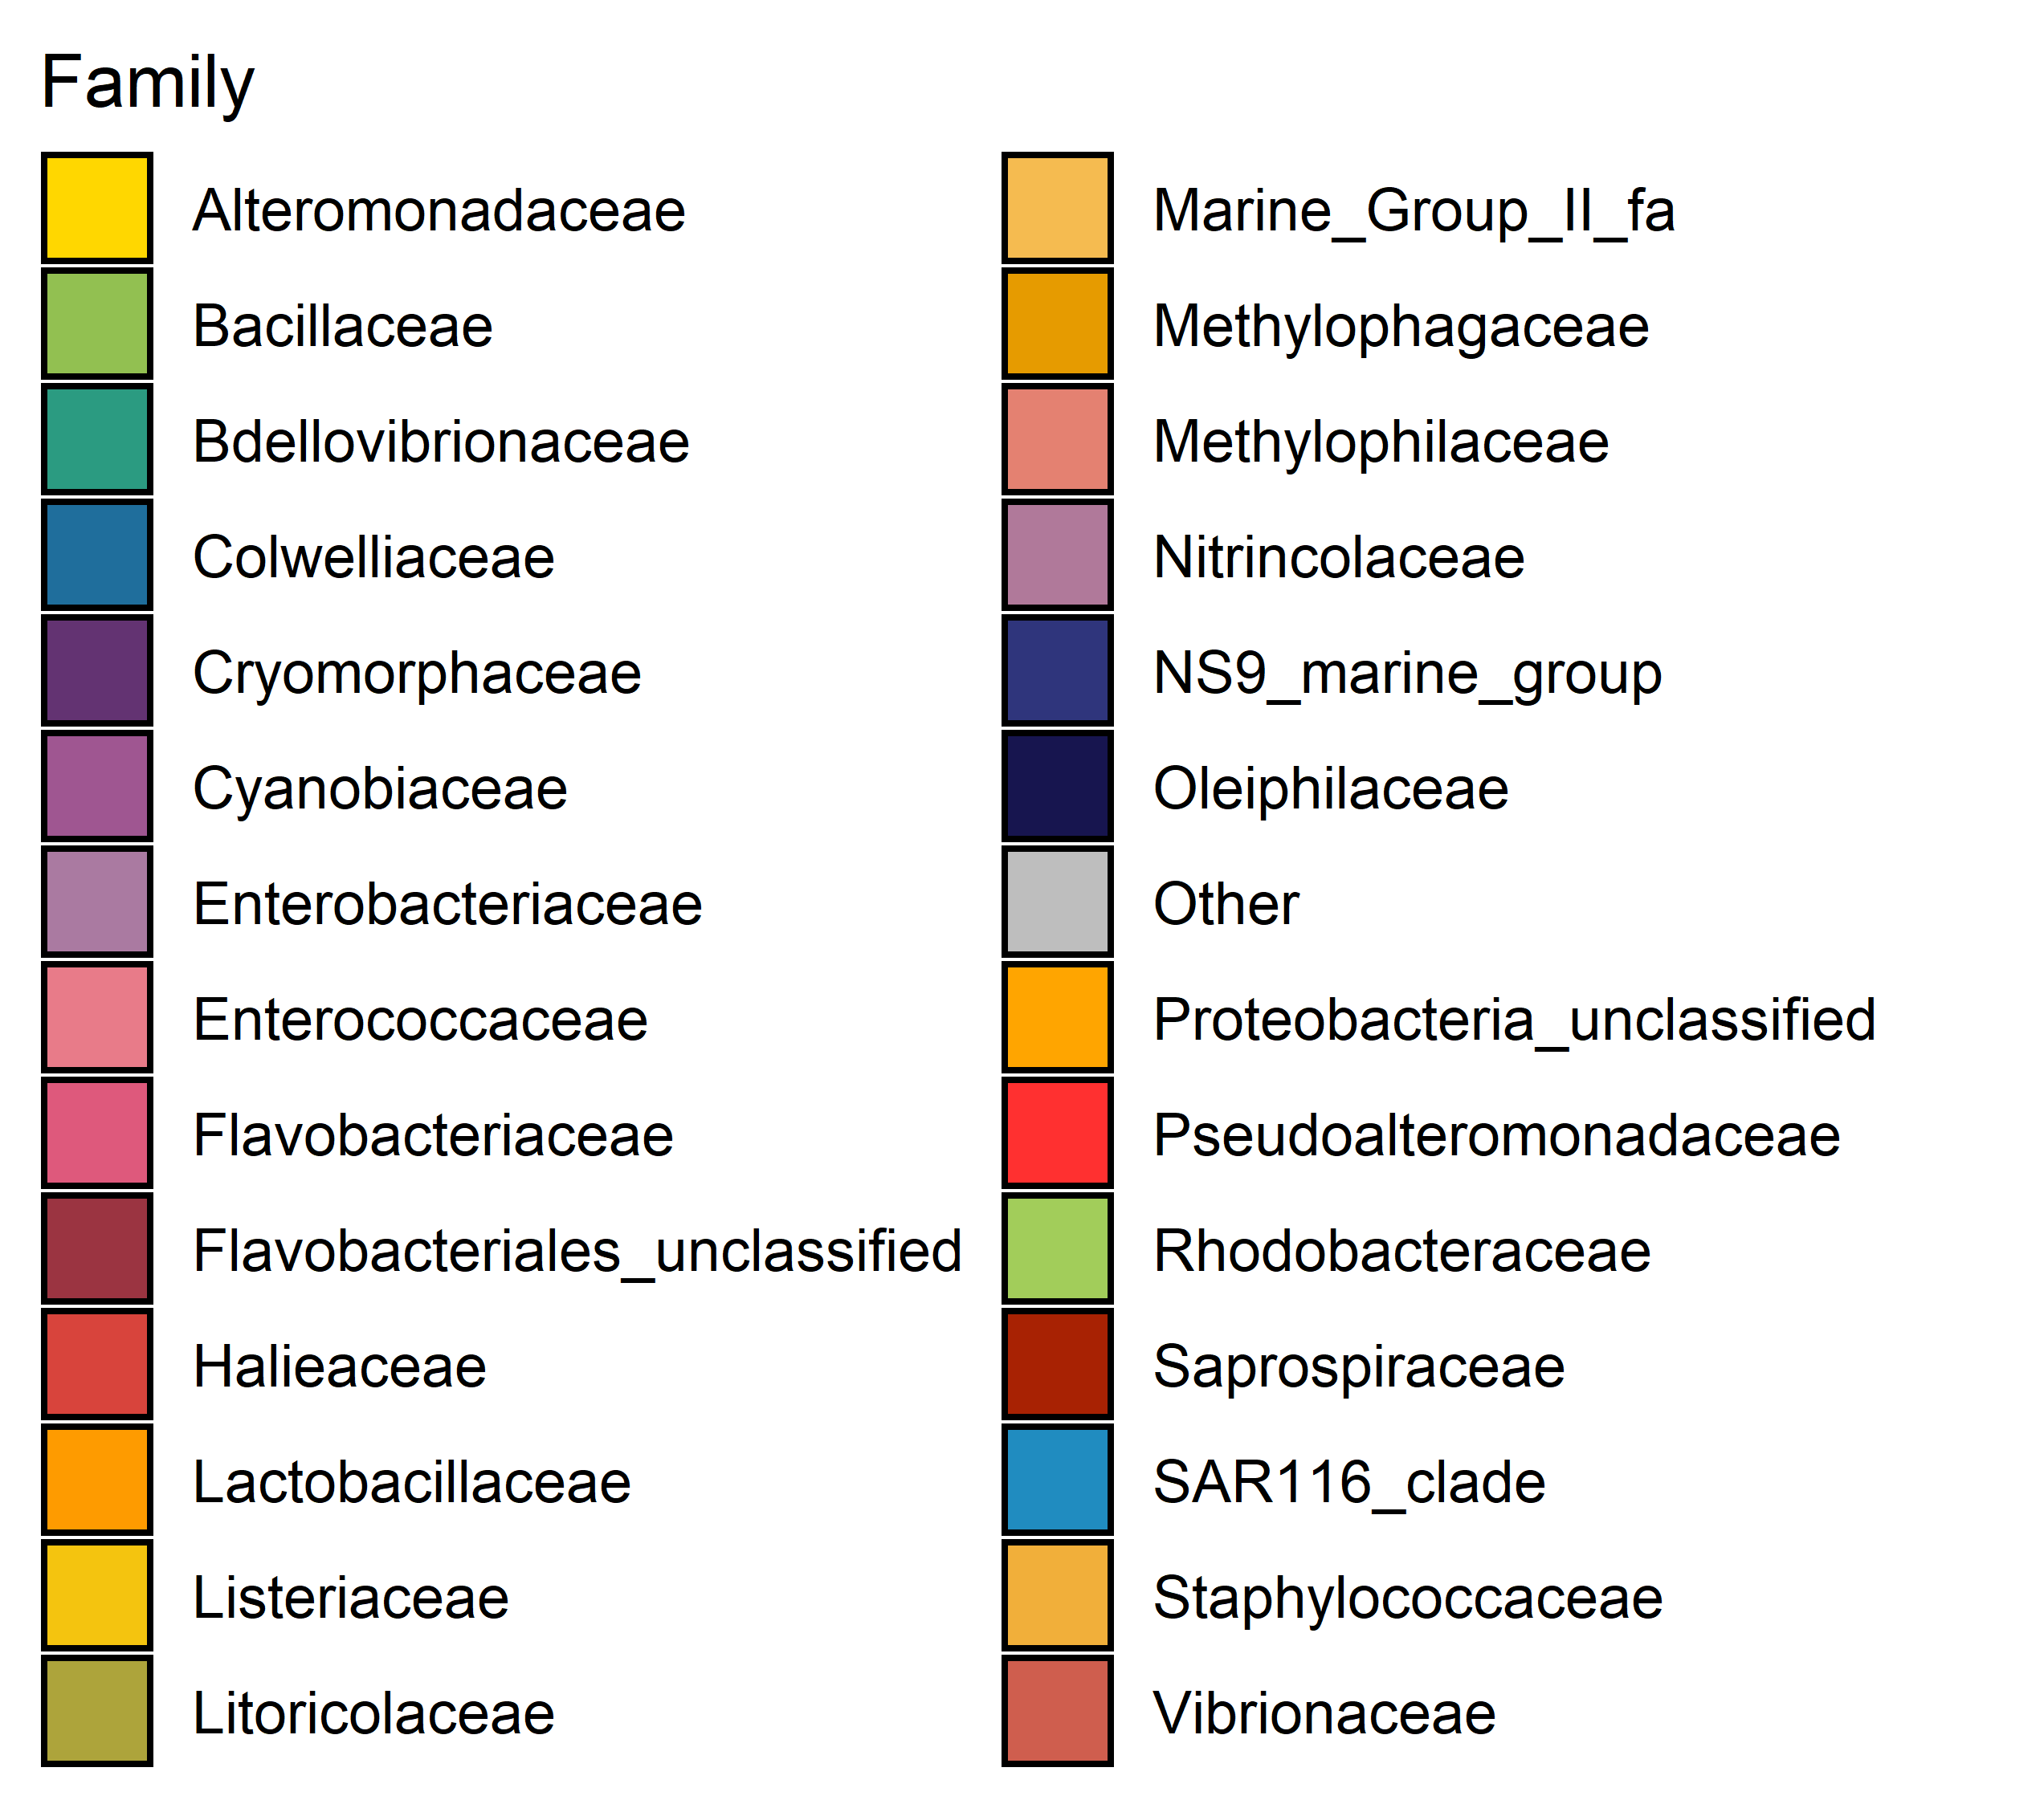
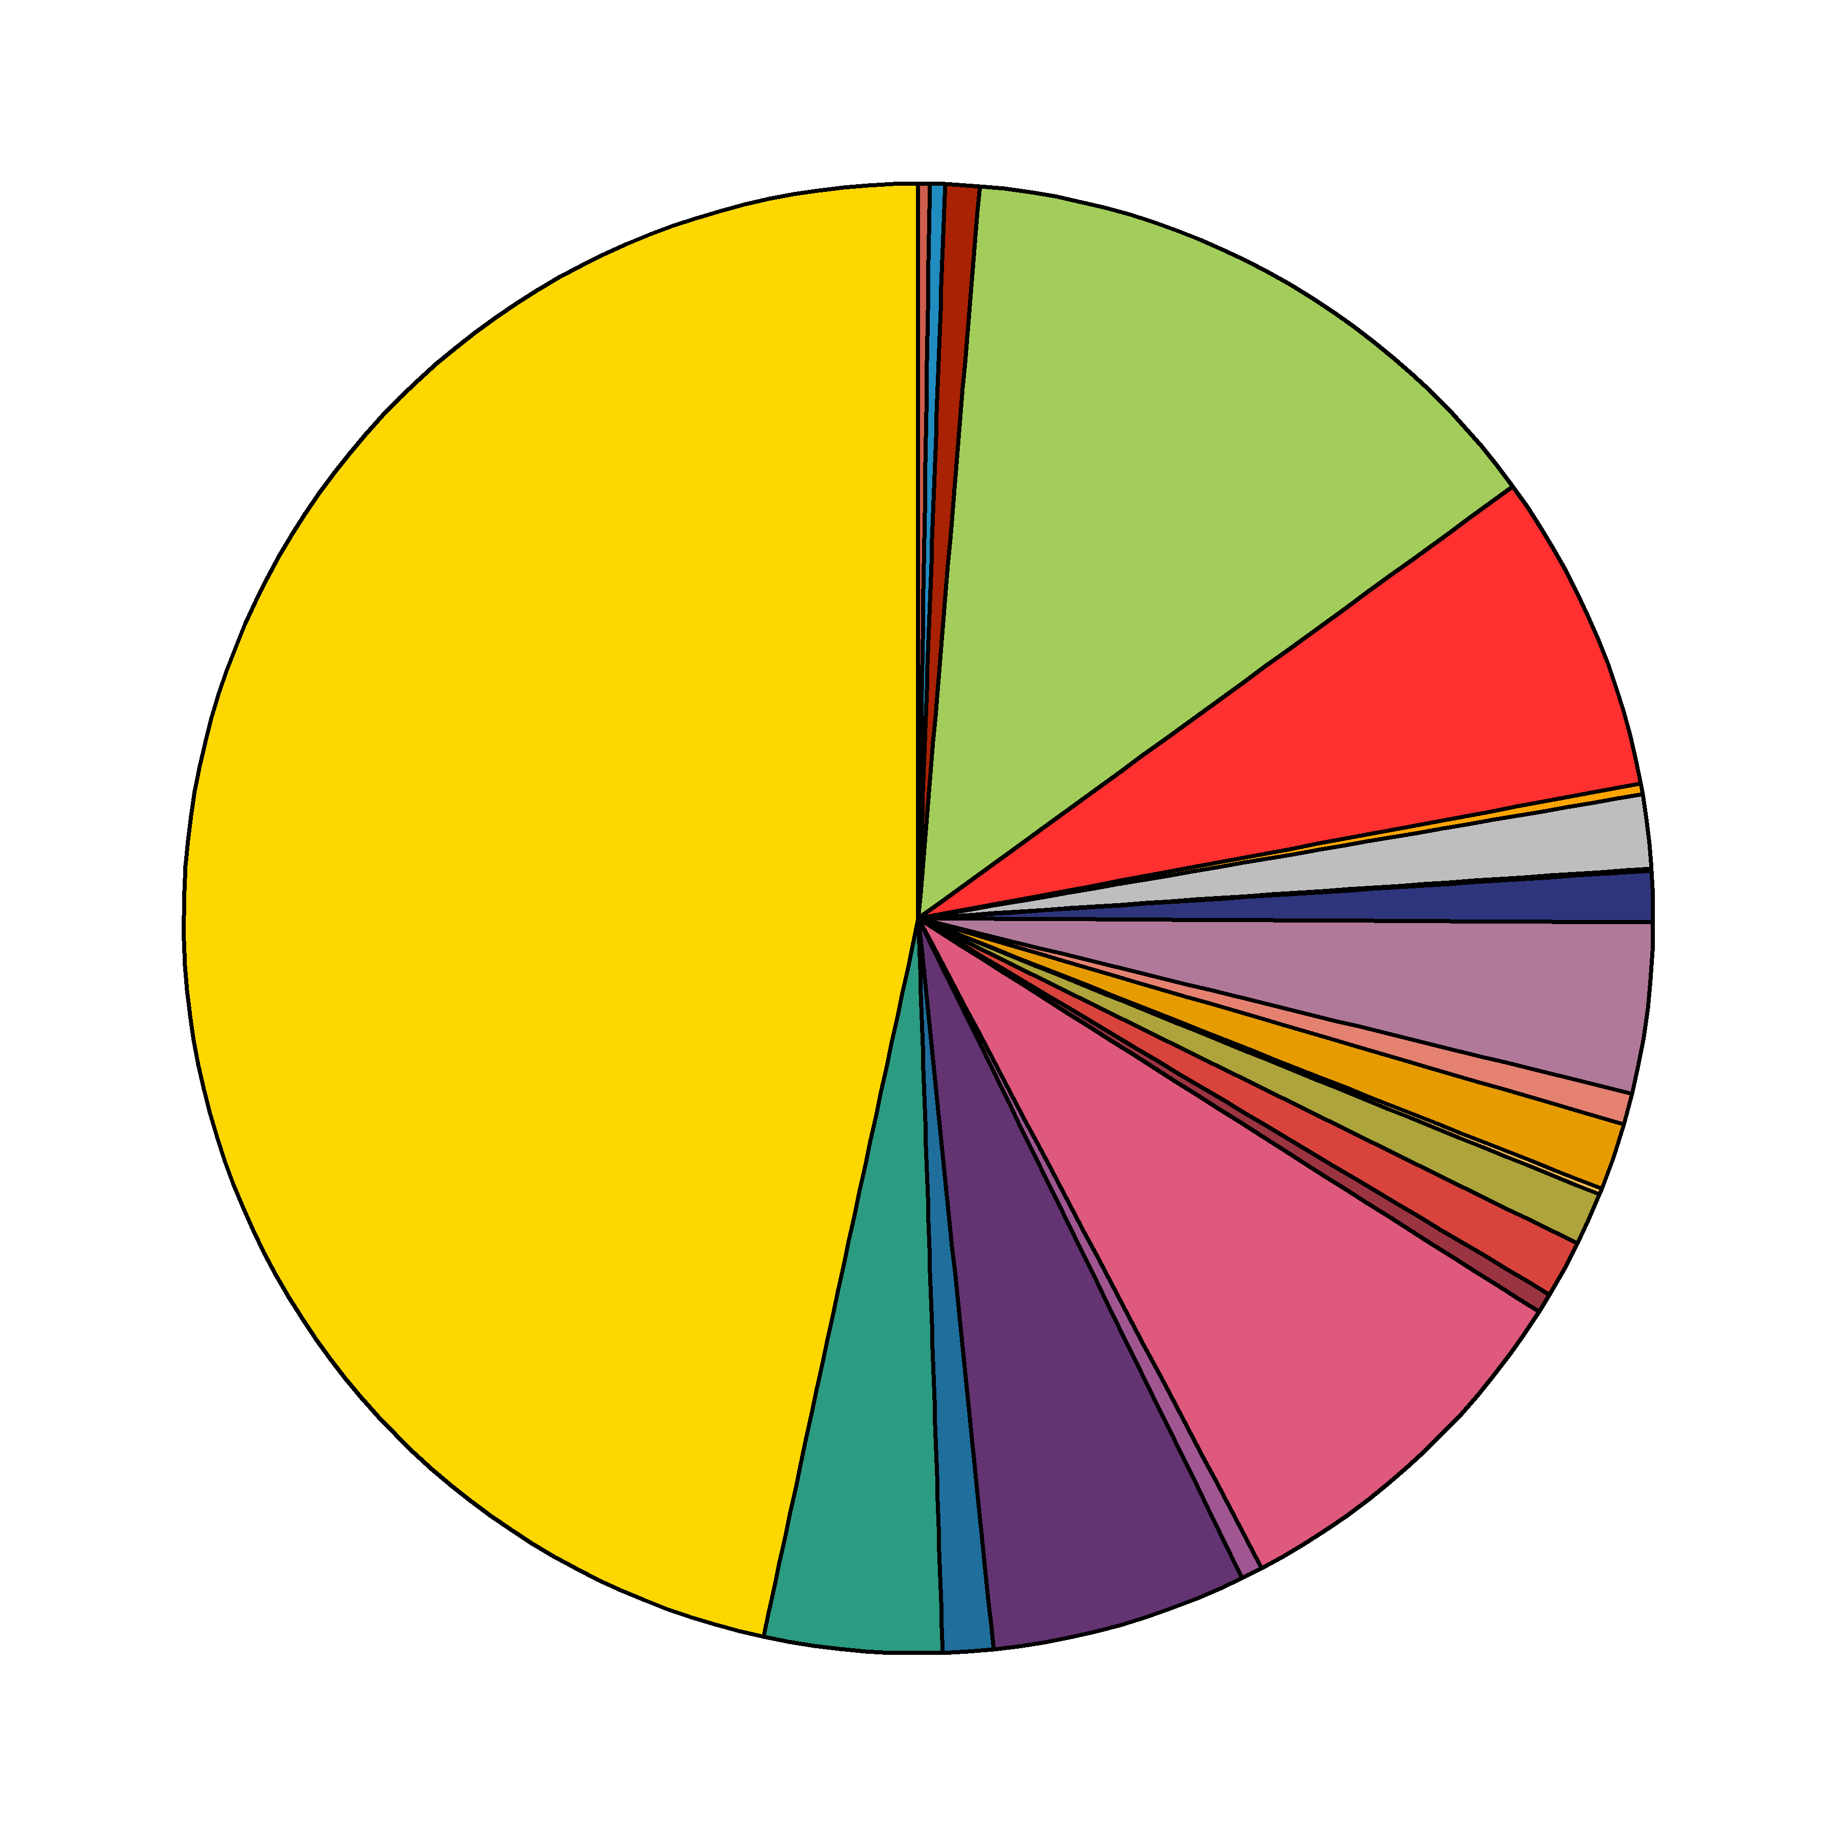
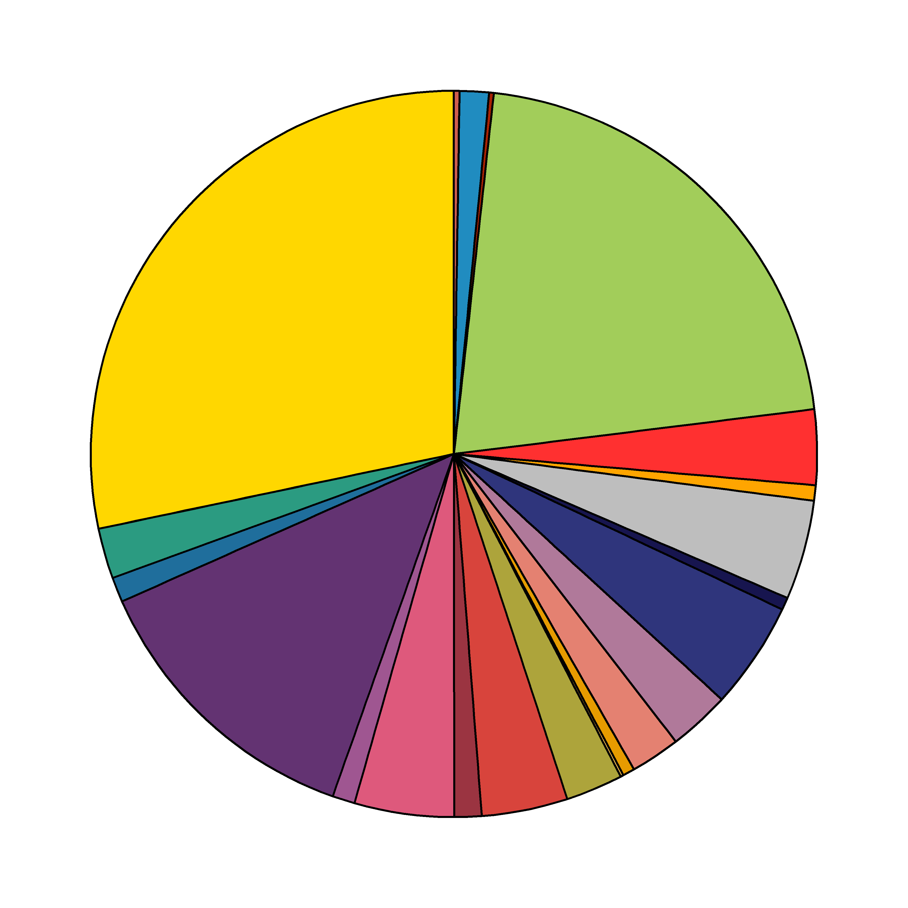
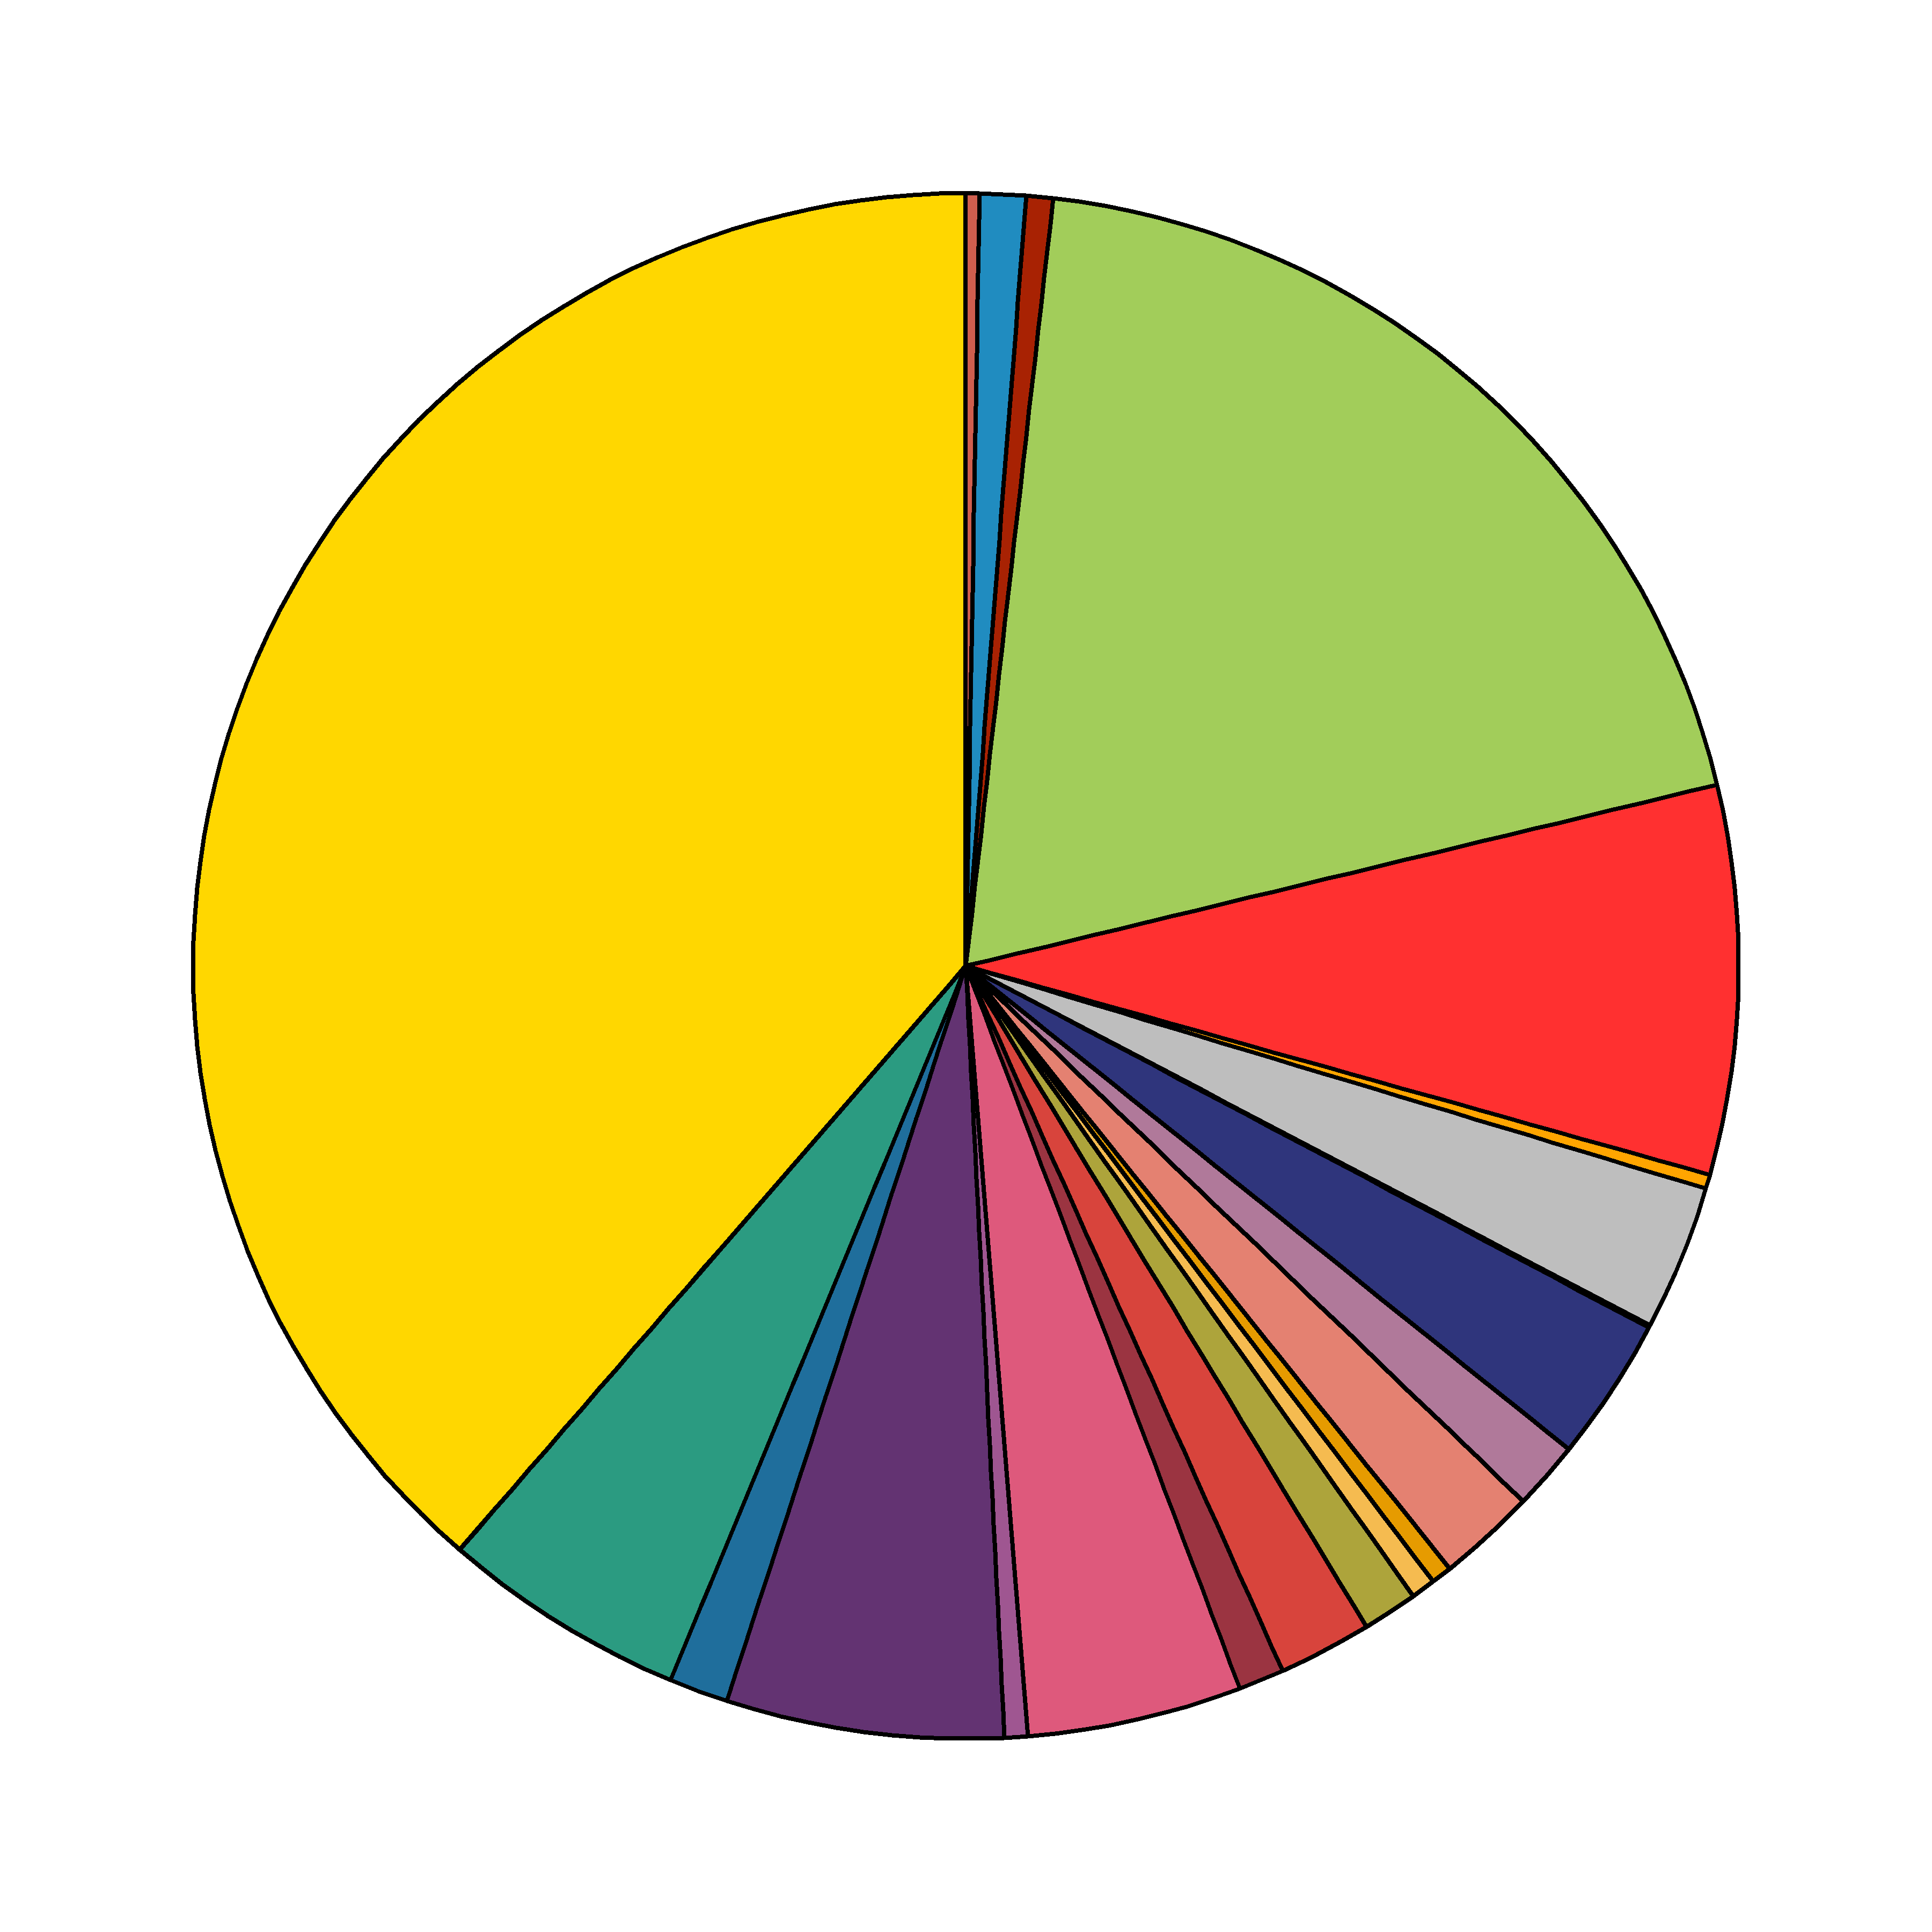
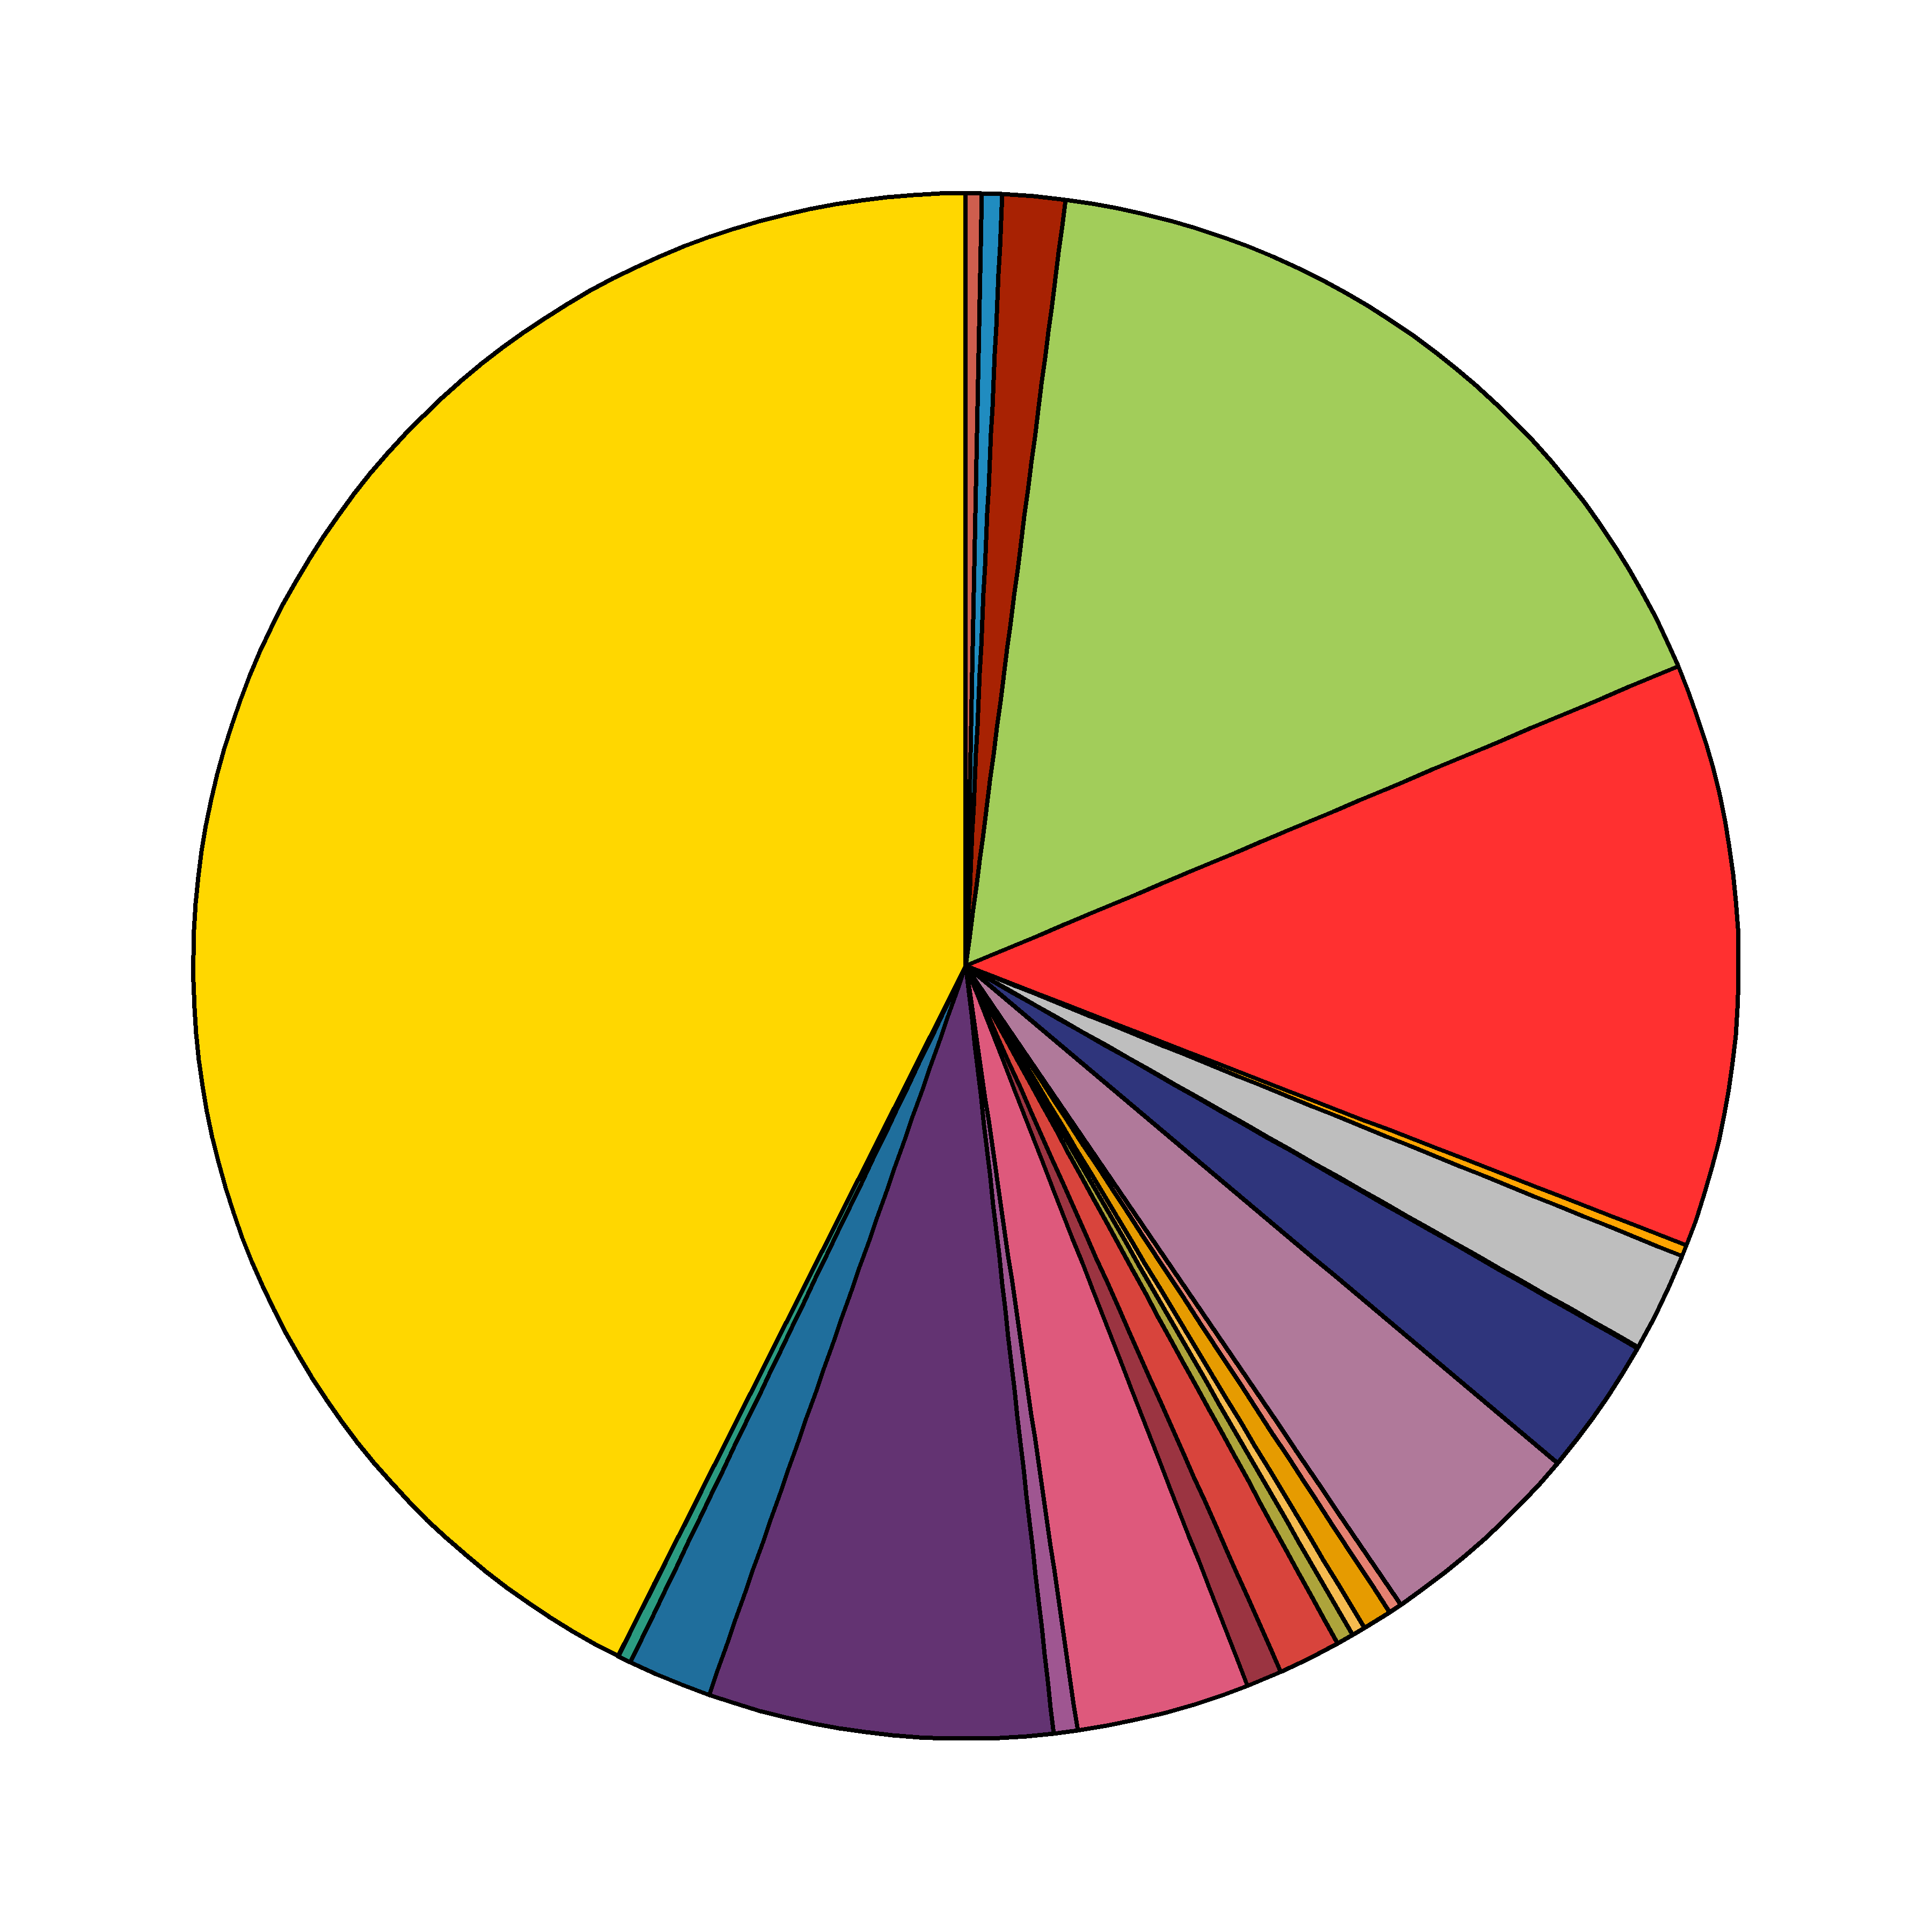
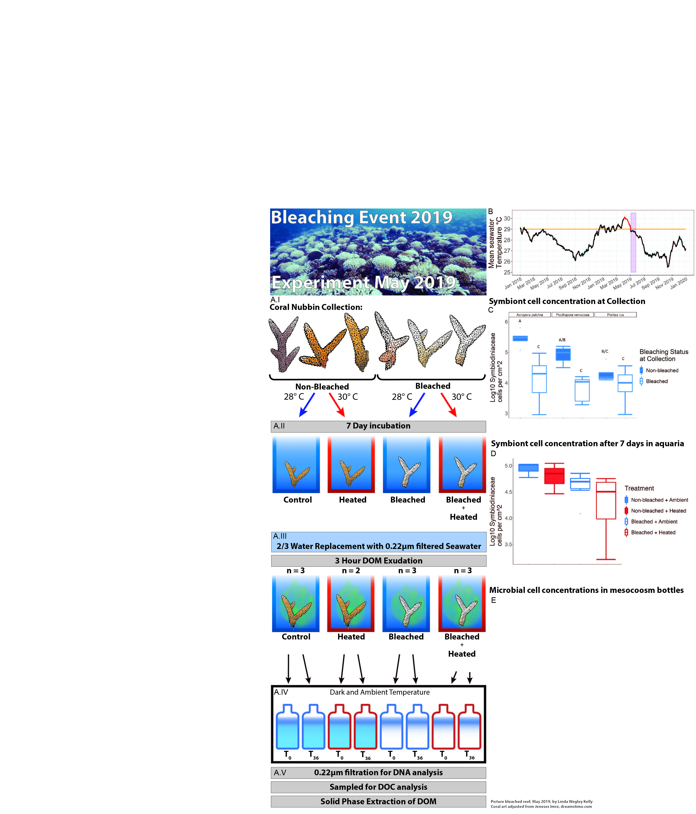
Microbialized
Healthy
Microbialized
Microbialized
Hypoxia, disease
DOM
Hypoxia, disease
Hypoxia, disease
DOM
DOM
DOM
“Healthy”
“Thermal Stress Onset”
“Peak Bleaching”
“Recovering”
Non-bleached + Ambient
Non-bleached + Heated
Bleached + Heated
Bleached + Ambient
Temperature
Time

